Slide 1

Lincoln Laboratory Ad-hoc MIMO Adaptive Communication Simulation Tool
Adam Margetts, Derek Young, Bruce McGuffin, Dan Bliss, Glenn Fawcett, and Lloyd the Llama
DISTRIBUTION STATEMENT A. Approved for public release. Distribution is unlimited.
This material is based upon work supported by the Defense Advanced Research Projects Agency under Air Force Contract No. FA8702-15-D-0001. Any opinions,findings, conclusions or recommendations expressed in this material are those of the author(s) and do not necessarily reflect the views of the Defense Advanced Research Projects Agency. © 2019 Massachusetts Institute of Technology

Slide 2
This material is based upon work supported by the Defense Advanced Research
Projects Agency under Air Force Contract No. FA8702-15-D-0001. Any opinions,
findings, conclusions or recommendations expressed in this material are those
of the author(s) and do not necessarily reflect the views of the Defense
Advanced Research Projects Agency.
© 2019 Massachusetts Institute of Technology.
This program is free software; you can redistribute it and/or modify
it under the terms of the GNU General Public License version 2 as
published by the Free Software Foundation;
THIS SOFTWARE IS PROVIDED BY THE COPYRIGHT HOLDERS AND CONTRIBUTORS "AS IS"
AND ANY EXPRESS OR IMPLIED WARRANTIES, INCLUDING, BUT NOT LIMITED TO, THE
IMPLIED WARRANTIES OF MERCHANTABILITY AND FITNESS FOR A PARTICULAR PURPOSE
ARE DISCLAIMED. IN NO EVENT SHALL THE COPYRIGHT OWNER OR CONTRIBUTORS BE
LIABLE FOR ANY DIRECT, INDIRECT, INCIDENTAL, SPECIAL, EXEMPLARY, OR
CONSEQUENTIAL DAMAGES (INCLUDING, BUT NOT LIMITED TO, PROCUREMENT OF
SUBSTITUTE GOODS OR SERVICES; LOSS OF USE, DATA, OR PROFITS; OR BUSINESS
INTERRUPTION) HOWEVER CAUSED AND ON ANY THEORY OF LIABILITY, WHETHER IN
CONTRACT, STRICT LIABILITY, OR TORT (INCLUDING NEGLIGENCE OR OTHERWISE)
ARISING IN ANY WAY OUT OF THE USE OF THIS SOFTWARE, EVEN IF ADVISED OF THE
POSSIBILITY OF SUCH DAMAGE.

Slide 3
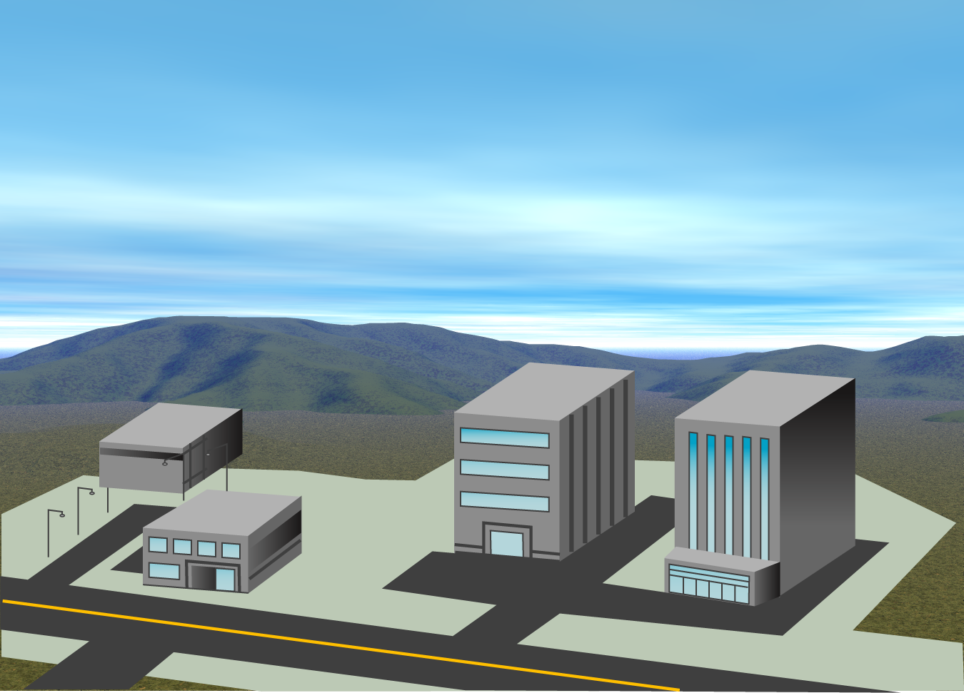
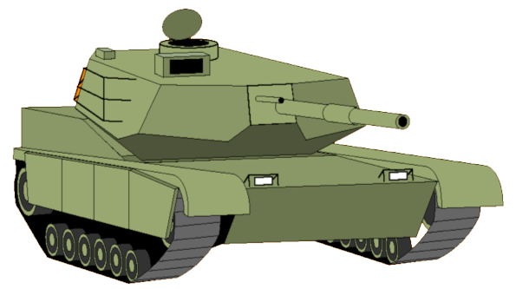
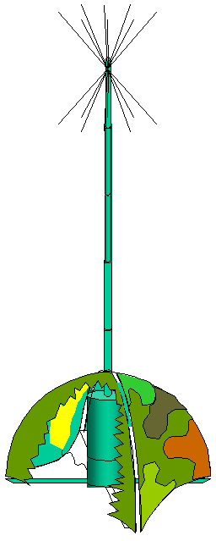
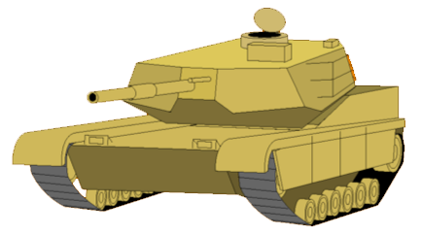


Simulation Environment Overview
Interference
Dynamic center frequencies
Space-Time-Frequency Correlation
Propagation Losses
Multipath
CorrelatedShadowing
MIMO Systems
Cognitive
Comms
Ad-hoc Networks
Notes:
This is a representative scenario we would like to emulate

Slide 4
Simulation Capabilities
Operate multiple radio nodes simultaneously and asynchronously
Generate realistic space-time-frequency MIMO fading channels
Model propagation over a variety of environments:
Urban, suburban, rural
Indoors, outdoors, fixed, mobile, or airborne
Line-of-sight or non-line-of-sight
Link lengths meters to tens of kilometers
Frequencies: 10 MHz to 6 GHz

Slide 5
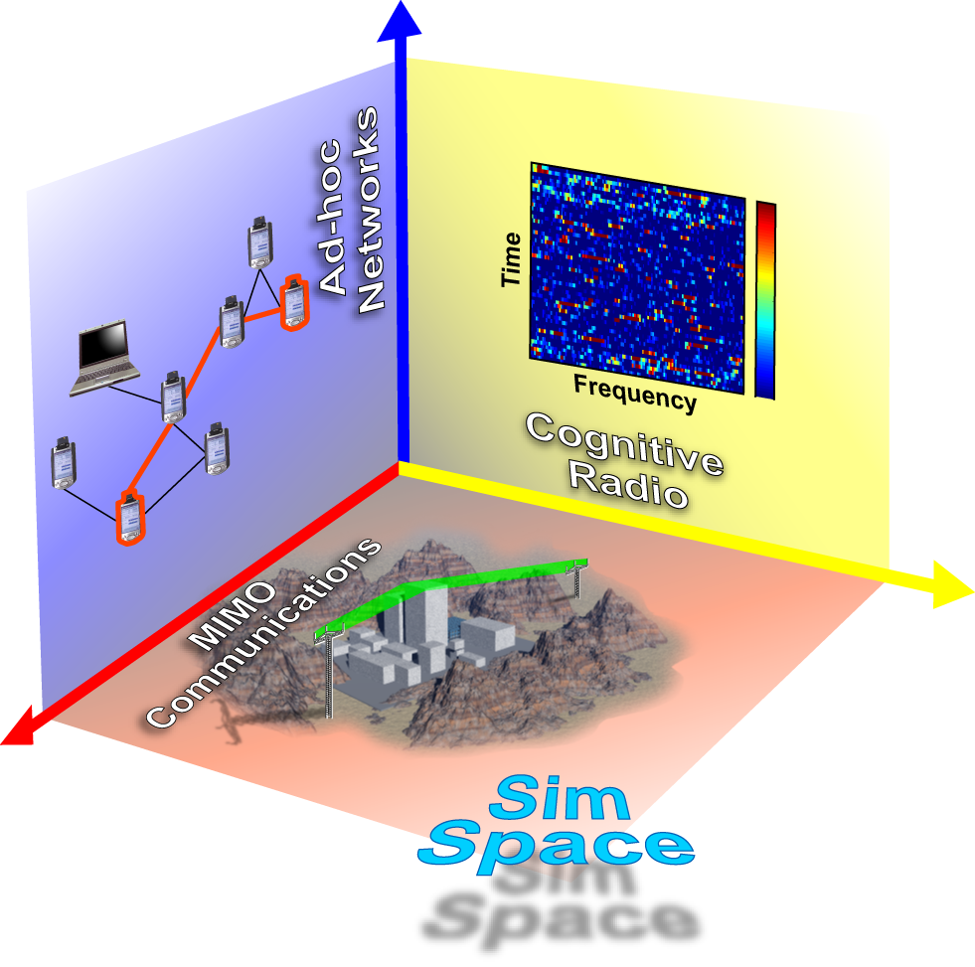
Problem Set
Motivating Scenarios:
Cognitive Radios
Ad-hoc Radio Networks
MIMO Communications
LLAMAComm combines all three!

Slide 6
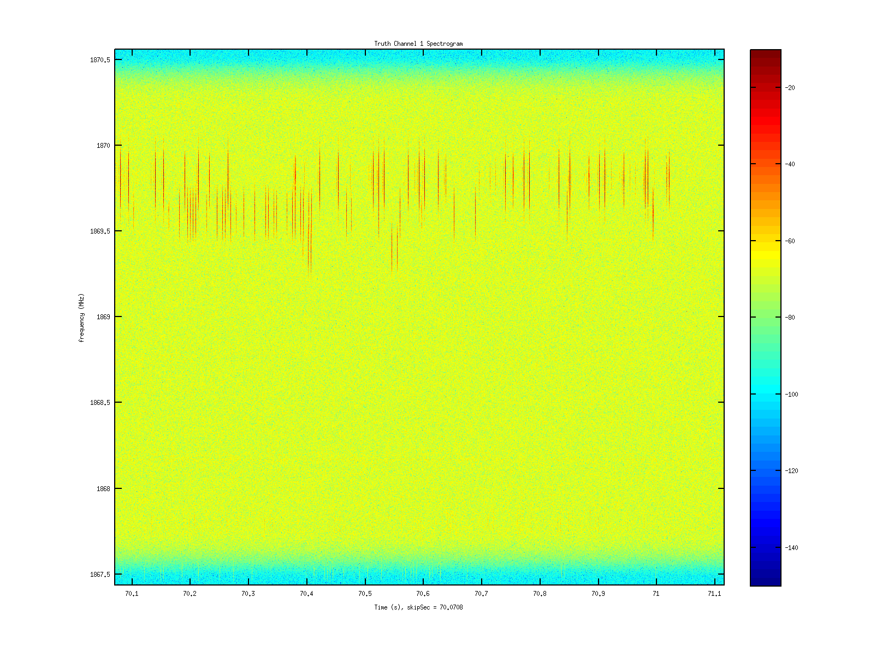
Adaptive Cognitive Radio
Radio spectrum is underutilized
Cognitive radios identify and occupy time-frequency gaps
Requires simulating a wide range of center frequencies
Spectrum Occupancy
Cognitive Radio Scenario
1.5
-20
1.0
-40
.5
Received Power (dBm)
-60
Frequency (MHz)
0
-80
-.5
-100
-1.0
-120
-1.5
-140
0
.25
.5
.75
1.0
Time (Sec)

Slide 7
Wireless Ad-hoc Networks
Formed dynamically
Multi-hop communications
Nodes interact asynchronously
Simulation provides datalink layer control
Ad-Hoc Network Scenario

Slide 8
MIMO Communication Multiple-Input Multiple-Output
Arrays of antennas at transmitter and receiver
Increases reliability and throughput
Adaptively nulls interference sources
Simulate space-time-frequency correlations
MIMO Communications Example

Slide 9
Available Wireless Network Simulators
Opnet
Commercial
Probabilistic physical layer
Ns2
Open source (large research user base)
Probabilistic physical layer
QualNet
Commercial
Probabilistic physical layer
ISIS Prowler (Probabilistic Wireless Network Simulator)
Gyula Simon (Vanderbilt University)
Written in Matlab
Probabilistic physical layer
SWANS (Scalable Wireless Network Simulator) (built on JiST)
Claimed 1,000,000 nodes simulated on a PC
Probabilistic Physical Layer
Numerous cell-site planning tools
Wireless Insight (cousin to XFDTD)
Solves Maxwell Equations
Physical Layer
Too Simple
Too Complex
Simulation should be as simple as possible, but no simpler

Slide 10
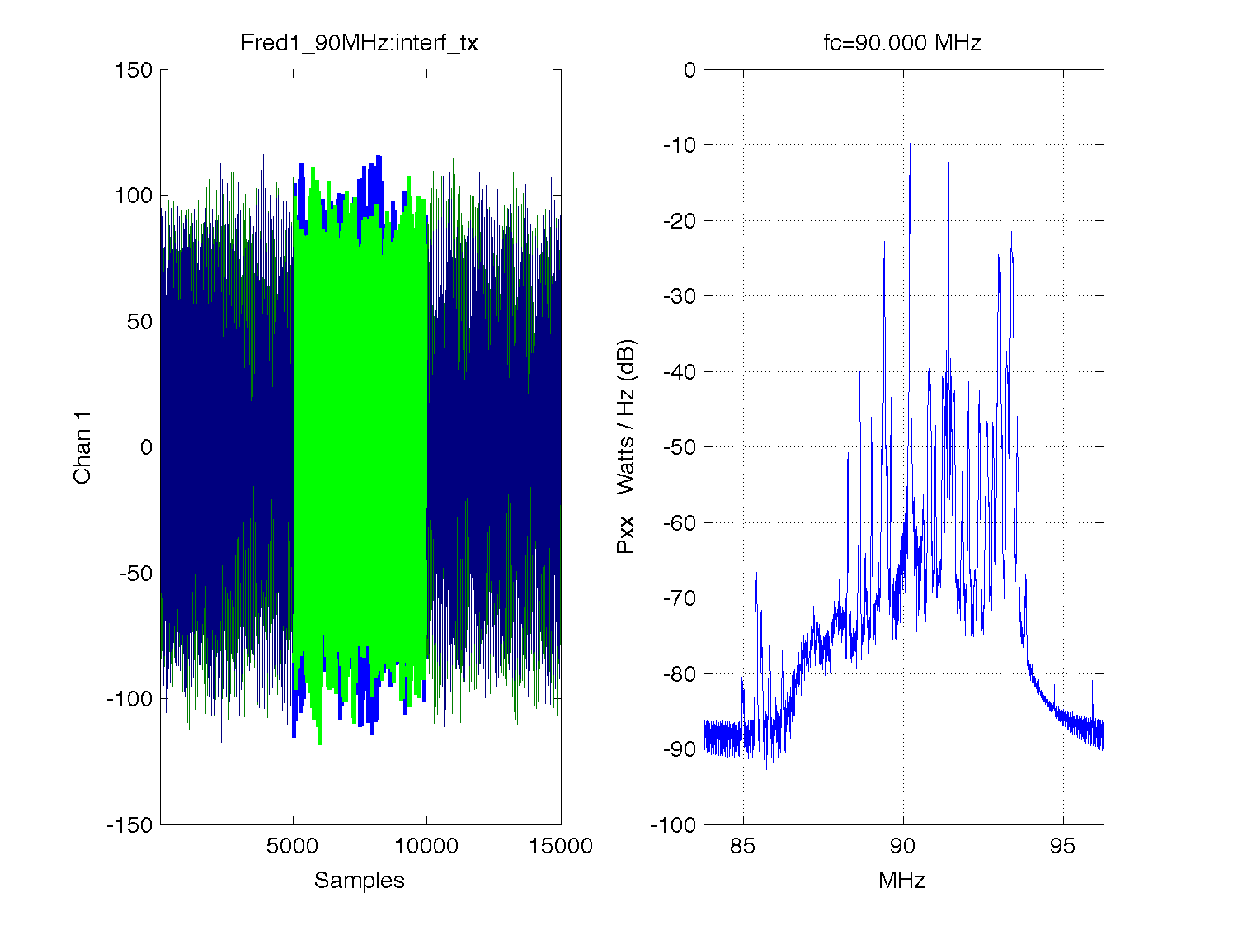
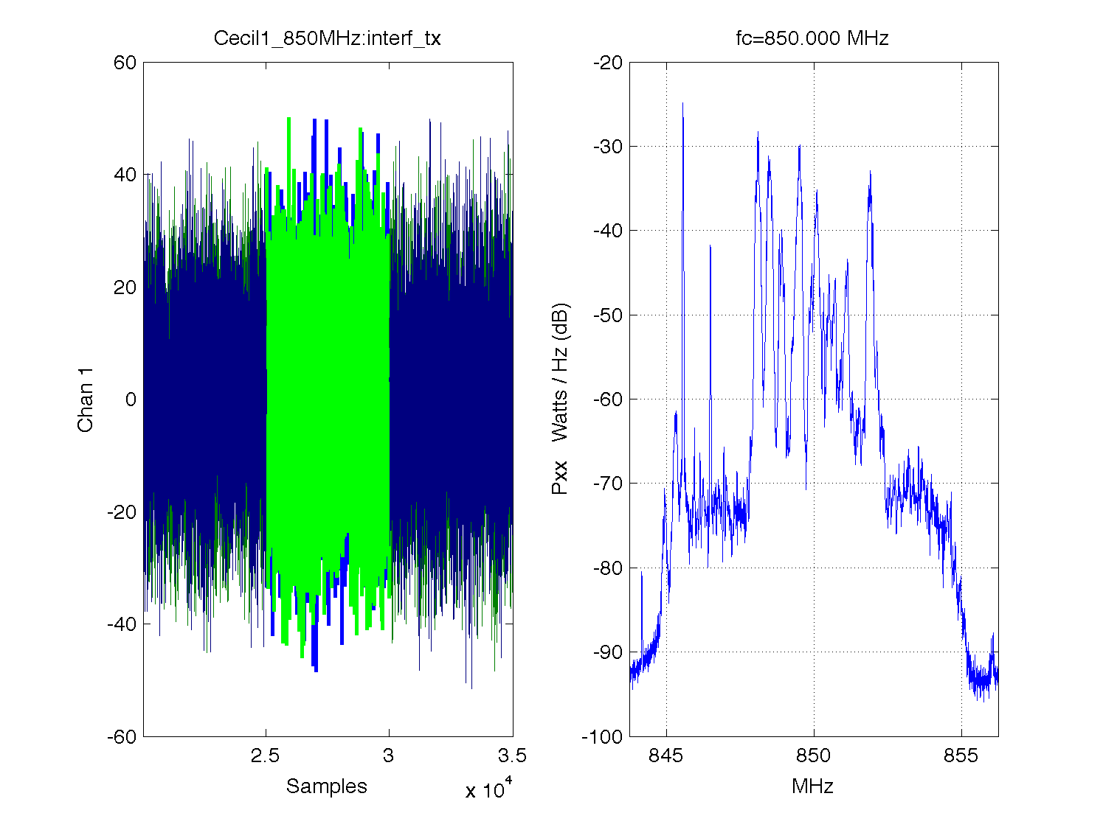
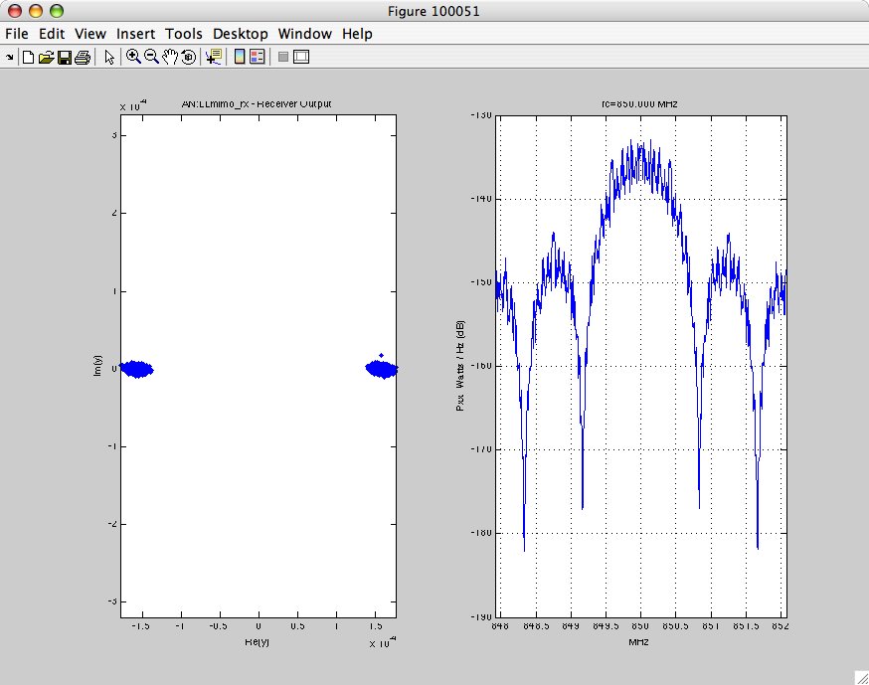
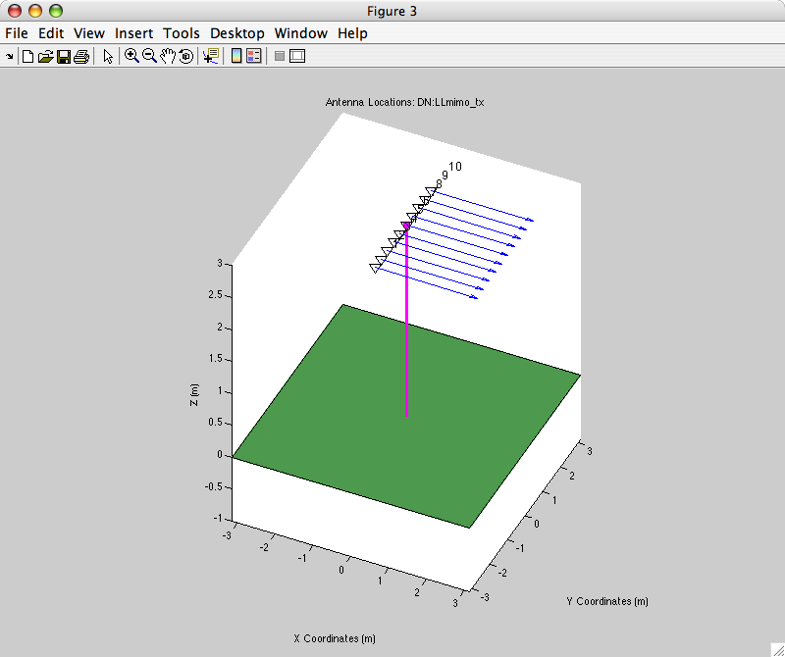
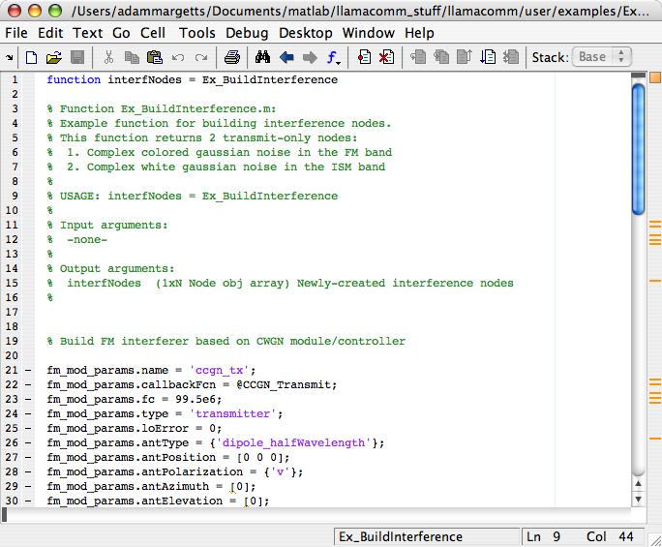
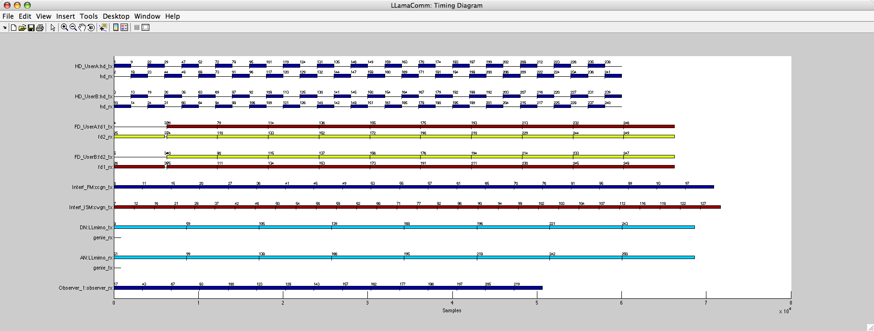
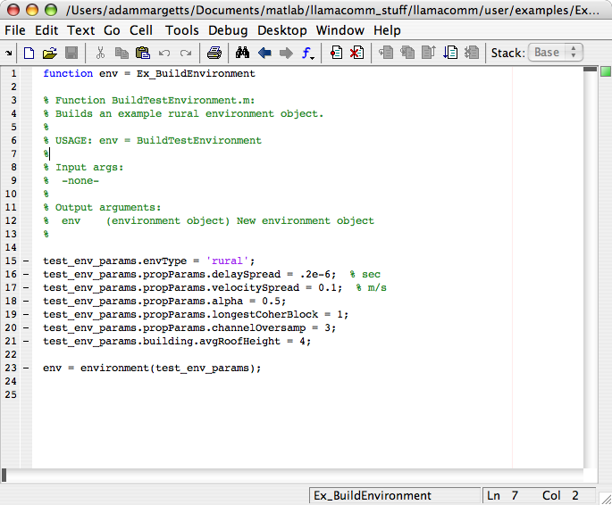
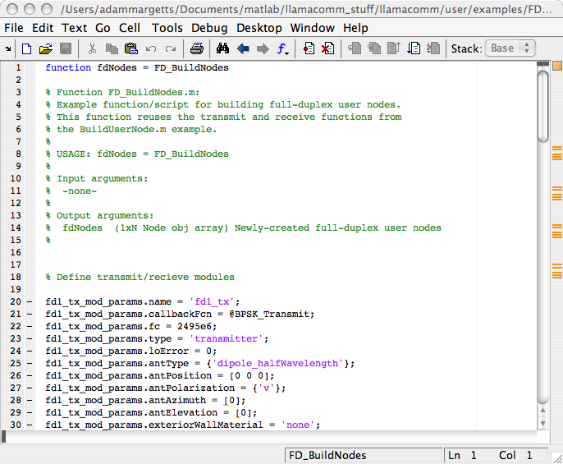
LLAMAComm Overview
LLAMAComm is a MATLAB simulation tool
Simulates cognitive Multiple-Input Multiple-Output (MIMO) ad-hoc wireless networks
LLAMAComm
Recorded Interference
Results
Statistical Environment Models
User-Defined Functions and Parameters
Start
Transmit
Decide
Receive
Done
Timing Support

Slide 11
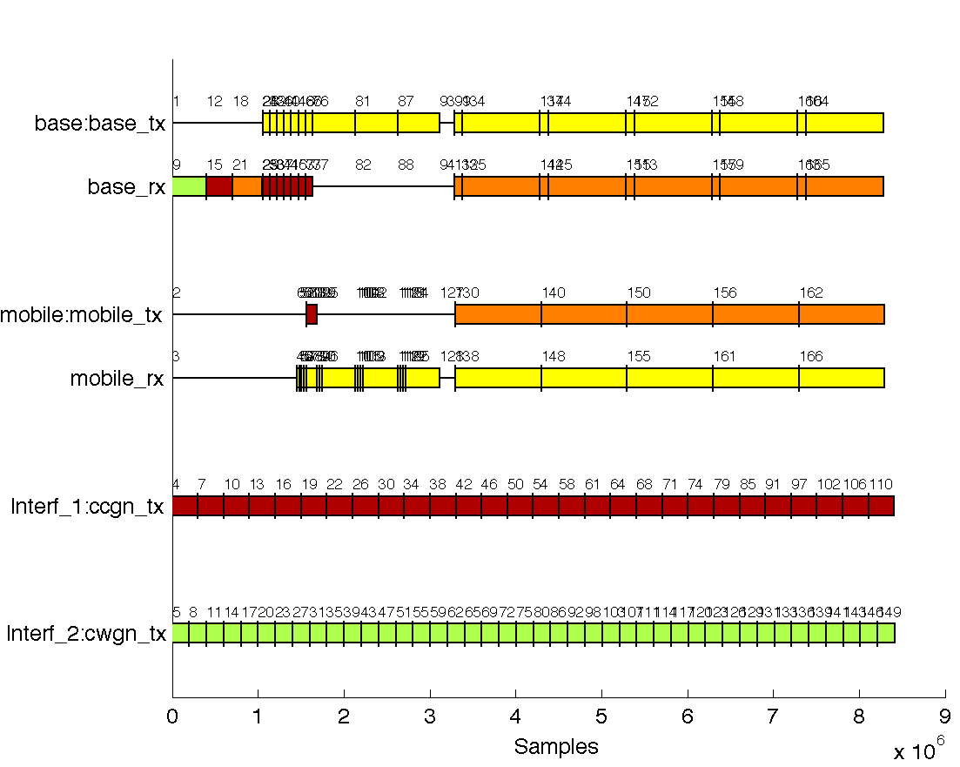
LLAMAComm Timing Diagram Example
Complex datalink simulations are possible
Colors indicate center frequency
Pilot Tx
Control Tx
Downlink Tx
Cognitive
Radios
Spectrum
Monitoring
Sync Rx
Uplink Rx
Sync Tx
Downlink Rx
Pilot Rx
Control Rx
Downlink Rx
Interference

Slide 12
LLAMAComm Requirements
MATLAB R2009b or later
Signal processing toolbox
Familiarity with MATLAB programming
Fast processor

Slide 13
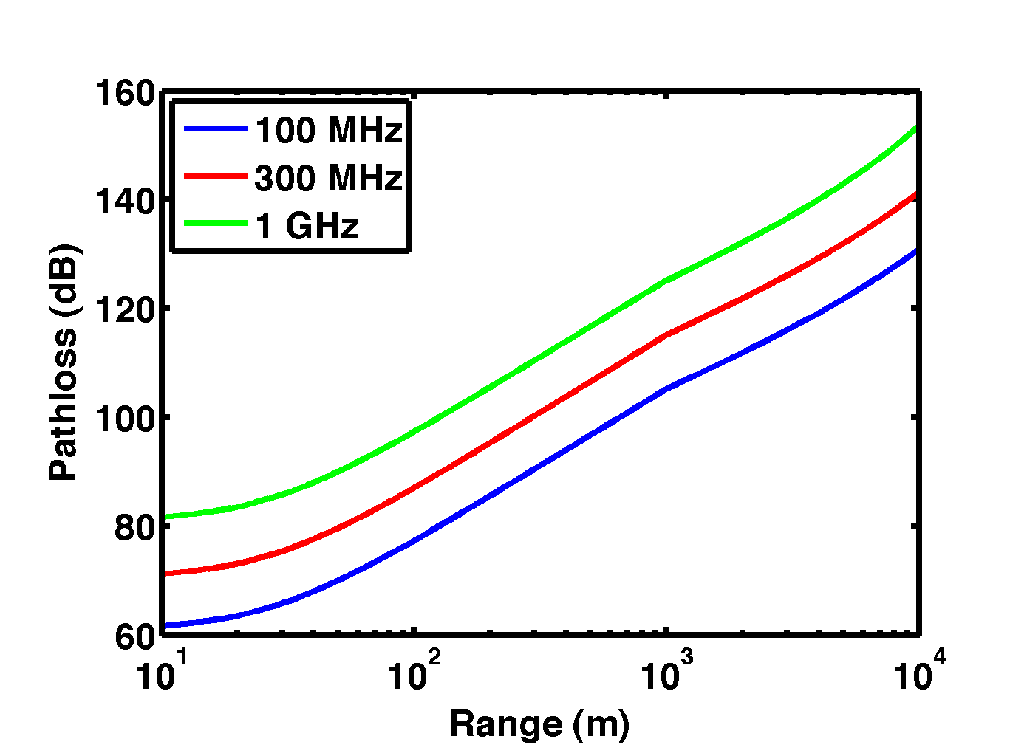
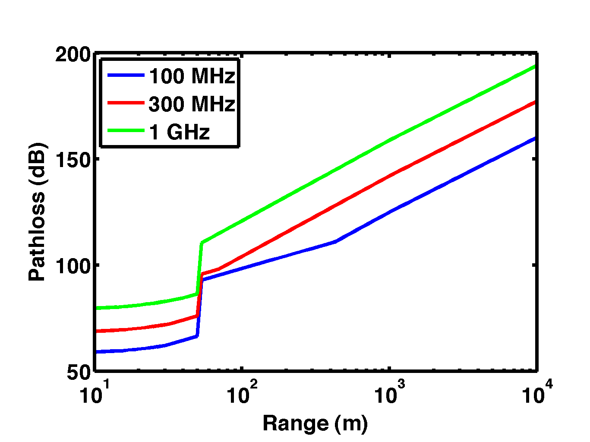
Scope of LLAMAComm Path Loss Models
Input parameter range
frequency: 10 MHz – 6 GHz
range: 1 m – 300 km⁽¹⁾
antenna height: 1 m – 10 km
Supported environments
urban/suburban/rural
in-building/building penetration/ outdoors
Model Outputs
log-normal shadowing loss
median power loss
standard deviation
shadowing correlation with angle
multipath fading
Rice k-factor
delay spread
Rural
Median Path Loss (dB)
Urban
Median Path Loss (dB)
(1) Longer ranges only required for very high receivers

Slide 14
Path Loss Example
Examine path loss from Interferer to Receiver
Urban environment
Outdoors
Receiver below roof height
Range > 1 km
Path Loss Example
Interferer
Transmitter
Receiver

Slide 15
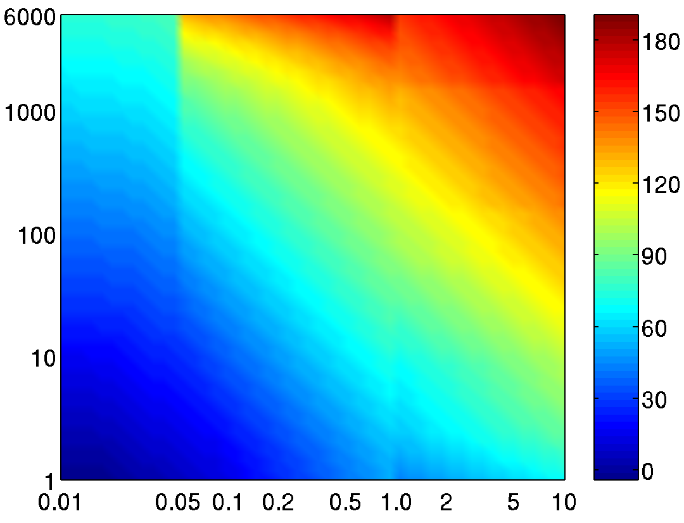
Path Loss Model 10 MHz-6 GHz, 10 m–20 km, Multiple Environments & Sites
Setting and Terminal Data:
Environment?
Indoors/Outdoors?
Indoor Range
External Wall Type
(concrete)
# Internal Walls
External Wall Angle
Terminal Heights?
Avg. Building Height
Range?
Center Frequency?
Environment:
Terminal Sites:
Terminal Heights:
(Lower/Higher)
Range:
Frequency:
Path Loss Median/
Standard deviation,
(Model Also Provides
Rice K-Factor,
Shadow-Loss Correlation Between Links)
Suburban...
One indoors…
Below roof height, Below roof height…
Urban
Both outdoors
Below roof height,
Near roof height…
Range < 50 m…
Both indoors...
Freq < 150 MHz (Longley-Rice w/Urban Correction/
Okumura-Sigma)
Rural…
Range < 1 km…
Below roof height,
Above roof height and below 200 m
Median Path Loss (dB) in Urban Environment, Avg. Building Height 18 m, Tx Height 2 m, Rx Height 30 m
Range > 1 km
(max depends on freq)
150 MHz < Freq < 1500 MHz
(Hata/Okumura-Sigma)
Below roof height, Above
200 m…
Frequency (MHz)
Freq > 1500 MHz
(Hata w/ COST Freq. Correction, Okumura-Sigma)
Assumed LOS to NLOS Transition
Above roof height,
Below 1000 m…
Existing Models,
Extensions or Modifications of Existing Models, or New Models As Required
Above roof height,
Above 1000 m…
Range (km)
Notes:
Blue is path loss, pink is standard deviation

Slide 16
Urban/Suburban Path Loss Models at 2 GHz Node 1 Indoors
Path loss model includes indoor-to-outdoor links
Loss depends on range, antenna heights, frequency, etc.
c
10 km
Indoors
Indoors to LOS outdoors
Below roof height
Above roof height
3 km
COST-231 Building Penetration Model to LOS Exterior Node
With Frequency Extensions
Hybrid Urban/Suburban Model Plus LOS Above 200 m Or Beyond 20 km
1 km
300 m
100 m
Walfisch with Okumura Correction
Okumura-Hata Model & Cost-231 Frequency Extension
Node 2 Antenna Height
a)
b)
c)
d)
In-room composite model
In-building (NLOS) composite model
Assumed max. range for LOS to building. Use NLOS building penetration model plus outdoor path loss model for greater ranges.
Assumed mean roof-height varies with environment
30 m
10 m
COST-231 Walfisch-Ikegami Model
d
3 m
a
b
1 m
1 m
3 m
10 m
30 m
100 m
300 m
1 km
3 km
10 km
30 km
100 km
300 km
Ground Range

Slide 17
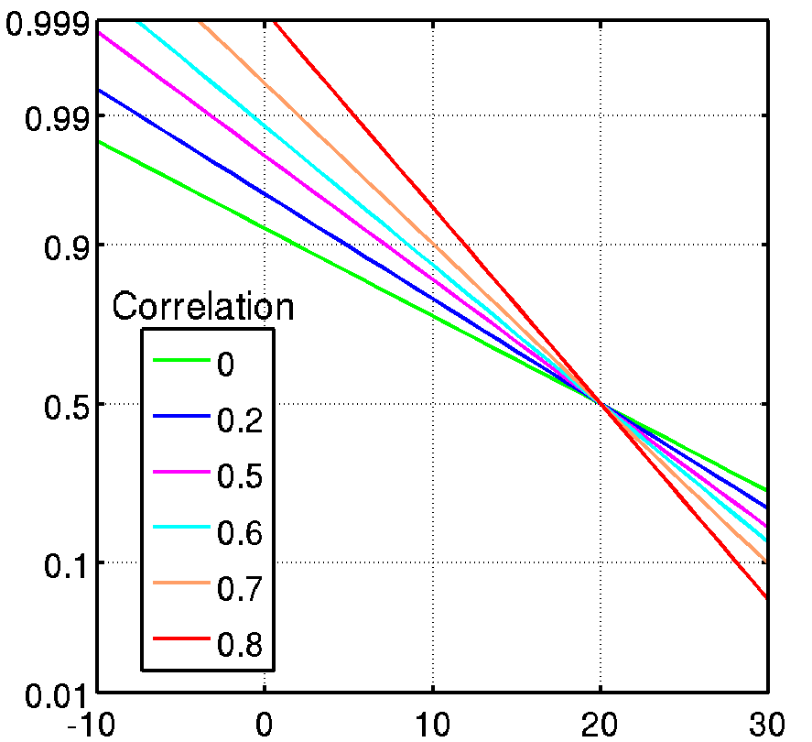
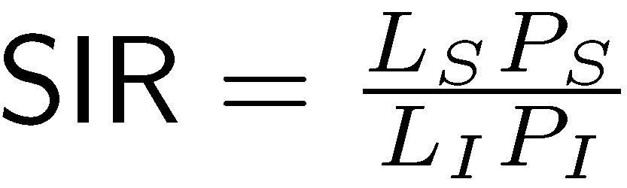
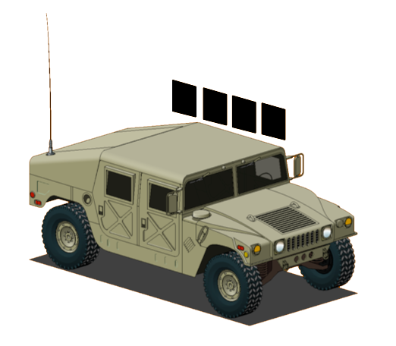
Correlated Shadowing
Shadow loss correlation reduces
signal-to-Interferer power variation
Signal
Interferer
Probability SIR > x for correlated links
High Correlation
Low Correlation
Probability
SIR > x
Interference
Shadowing Loss in dB is N(0,σ_{i})
Signal Shadowing Loss in dB is N(0,σ_{s})
ΔAz, φ
Copy Threshold
Average SIR
x (dB)
Example: Average SIR = 20 dB
Shadowing Std. Dev. = 10 dB
Copy Threshold = 10 dB
Copy Prob. Varies from 76% to 94%
Links to Common Node Have correlated Shadow Loss

Slide 18
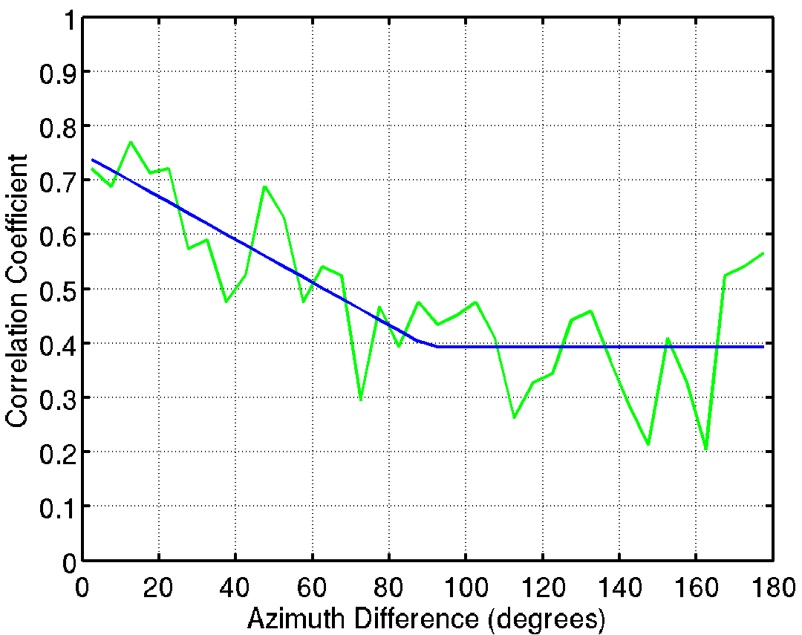
Shadowing Correlation Coefficient
Link shadow loss is correlated
Depends on angle separation
Limited data available
Graziano measured at 900 MHz around Washington Beltway¹
Similar results by van Rees at 150 MHz, 450 MHz, 900 MHz in The Hague²
Approximate Graziano’s measurements with bilinear fit
Lower MSE than proposed functions found in literature
Min > 0 reflects homogeneous environment in different directions
Max < 1 reflects uncorrelated shadowing at far end of links
Graziano Beltway Data¹
Measured Correlation
Bilinear Fit
Baltimore, MD
Reston, VA
Azimuth difference φ
Sheraton
Hotel
Winchester, VA
Victor Graziano, “Propagation Correlations at 900 MHz”, IEEE Trans. Veh. Tech., Nov. 1978
Jan van Rees, “Cochannel Measurements for Interference Limited Small-Cell Planning”, Archiv Elek. Ubertrag., 1988, pp 318-320

Slide 19
Channel Processing Example
Interferer operates at nearby center frequency
Causes interference
Interferer
Transmitter
Receiver

Slide 20
Signal Representation
Passband Model
Interferer
Transmitter
x
90º
+
Channel
x
Transmitter
Receiver
Channel
Received
Signal
Interferer
x
x
90º
+
90º
+
LPF
+
x
x
x
Noise
Baseband Equivalent Model Used by LLAMAComm
Pathloss
STF (Space-Time-Frequency Selective)
Signal
x
STF Channel
LPF
Received
Signal
Pathloss
+
+
Interferer
x
x
STF Channel
Noise

Slide 21
Channel Model Options
‘STFCS’ (Space-time-frequency-correlated scattering)
Preserves spatial correlation
‘WSSUS’
Wide-sense stationary
uncorrelated scattering
Exponential power profile
Correlated Time-Frequency Channel Samples
Delay-Doppler Channel Taps
Time
Doppler
Doppler Spread
2-D FFT
Delay Spread
Frequency
Lag
‘LOS_AWGN’
Line-of-sight path loss in AWGN channel
For debugging only
Time-Varying Filters
Time-Invariant

Slide 22
‘STFCS’ channel model option
Space-Time-
Frequency
Selective
MIMO Channel
‘STFCS’ channel model was developed at Lincoln
Correlates signals over space, time, and frequency
The STFCS channel tensor is four dimensional:
R×T×D×L
R receive antennas
T transmit antennas
D Doppler taps
L lag taps

Slide 23
SISO Channel with Doppler and Multipath
x
[
n
]
T
r
a
n
s
m
i
t
S
a
m
p
l
e
s
Time-
Frequency
Selective
SISO Channel
(T transmit antennas x N samples)
x
[
n
]
y
[
n
]
×
×
Doppler Shift
D Doppler Taps
e
j
ω
n
e
j
ω
n
j
ω
n
×
0
1
e
D-1
Doppler
Doppler Spread
Scalar Filter
Delay Spread
(1 x L)
Lag
Single channel input
Time-frequency processing
Single channel output
+
y
[
n
]
R
e
c
e
i
v
e
S
a
m
p
l
e
s
(R receive antennas x N samples)

Slide 24
Spatially Correlated Static MIMO Channel
H
Spatially correlated static MIMO channel:
G is an R×T i.i.d. Gaussian matrix
U and V are random unitary matrices
α controls spatial correlation
What about MIMO channels with Doppler and Multipath?
Create time-frequency-space correlations

Slide 25
Sample the Time-Frequency Plane
Time
Frequency
Δt coherence time
Δf coherence bandwidth
Different H_{i,j}’s are uncorrelated with each other
Each H_{i,j} is spatially correlated
T_{LCB} is longest coherent block (environment property)

Slide 26
Interpolate the Time-Frequency Plane
Time
Frequency
Preserve spatial correlation

Slide 27
Convert to Doppler-Lag Plane
Time
Doppler
Doppler Spread
2-D FFT
Frequency
Delay Spread
Lag
Take 2-D FFT over each spatial component
Time -> Doppler
Frequency -> Lag

Slide 28
MIMO Channel with Doppler and Multipath
X
[
n
]
T
r
a
n
s
m
i
t
S
a
m
p
l
e
s
Space-Time-
Frequency
Selective
MIMO Channel
(T transmit antennas x N samples)
X
[
n
]
Y
[
n
]
×
×
Doppler Shift
D Doppler Taps
e
j
ω
n
e
j
ω
n
j
ω
n
×
0
1
e
D-1
Doppler
Doppler Spread
Matrix Filter
Delay Spread
(R x T x L)
Lag
Vector signal input
Space-time-frequency processing
Vector signal output
+
R
e
c
e
i
v
e
S
a
m
p
l
e
s
Y
[
n
]
(R receive antennas x N samples)

Slide 29
Building a Node Object in LLAMAComm
Example: building a receiver node
Note: A node can have any number of modules
Module Properties
name = ‘Receiver_module’;
callbackFcn = @receiver;
fc = 850e6;
type = ‘receiver’;
antPosition = [0 -1 2 …
Module Object
module
Class
Constructor
RX
Node Properties
name = ‘Receiver_node’;
location = [0 0 10];
velocity = [0 0 0];
controllerFcn = @Controller;
…
Node Object
node
Class
Constructor
Set
User
Parameters
Receiver
RX
Controller
User Parameters
observedBlocks = 0;
nBlocksToObserve = 10;
blockLength = 5000;
…

Slide 30
Simulation Procedure
Controllers request to transmit and receive
Arbitrator enforces causality
Go to step 1.
Arbitrator
Interferer
Interferer
Controller
TX
Environment
Receiver
Transmitter
Transmitter
RX
Controller
Receiver
Controller
TX
Notes:
Arbitrator enforces causality into the simulation

Slide 31

Flowchart of the Arbitrator
Arbitrator is the mailman
Arbitrator Start
Loop once per module
No
Request?
Wait Request
Tx Request
Rx Request
Request
Done
Call Transmit
Function
Query
Modules
Store Transmit
Signal
Complete?
No
Request
Done
Combine
Received Signals
Store Received
Signals
Call Receive
Function
Request
Done
Arbitrator End

Slide 32
Receiver Controller State Machine
Text Color Key:
Red: Input from Arbitrator
Blue: Request
Black: Inline Code
Functionality:
Receive N sample blocks
Arbitrator
start
Interferer
Controller
TX
Environment
Request RX
count = count + 1
Receiver
If RX Not Done
Do Nothing
If RX Done
Request RX
count ++
Transmitter
RX
Controller
receive_wait
Controller
TX
Timing Diagram
If RX Done & count >= N
set module to Done
Interferer
1
3
Transmitter
2
done
Receiver
4
sample time

Slide 33
Receiver Controller Matlab Code
p = GetUserParams(nodeobj); % Load the user parameters
currState = GetNodeState(nodeobj); % Load the current state
switch currState
case 'start'
nodeobj = SetModuleRequest(nodeobj,'observer_rx','receive',p.blockLen);
p.observedBlocks = p.observedBlocks + 1;
nextState = 'receive_wait';
case 'receive_wait'
requests = CheckRequestFlags(nodeobj); % Get request flag
if requests==0 % if RX Done
if p.observedBlocks>=p.nBlocksToObserve;
nodeobj = SetModuleRequest(nodeobj,'observer_rx','done');
nextState = 'done';
else % Receive another block and increment counter
nodeobj …
= SetModuleRequest(nodeobj,'observer_rx','receive',p.blockLen);
p.observedBlocks = p.observedBlocks + 1;
nextState = 'receive_wait';
end
else % Wait until block has been received
nextState = 'receive_wait';
end
case 'done'
nextState = 'done'; % Continue in Done state
status = 'done';
end
nodeobj = SetNodeState(nodeobj,nextState); % Set the next state
nodeobj = SetUserParams(nodeobj,p) % Set the user parameters
Text Color Key:
Red: Input from Arbitrator
Blue: Request
Black: Inline Code
Start
Request RX
count = count + 1
receive_wait
If RX Not Done
Wait
If RX Done
Request RX
count ++
If RX Done & count >= N
set module to Done
Done

Slide 34
Timing Diagram
LLAMAComm produces a timing diagram to simplify debugging
Each segment represents a transmit or receive sample block
Thin segments represent ‘wait’ blocks
Timing Diagram
Notes:
Picture shows LLAMAComm scenario with 6 radios.
Signals processed in a block-wise fashion. Blocks are referred to as segments. 100-10K+ samples.
Block lengths can be different, but all blocks are processed at the same sample rate.
So, a particular receive segment requires that all transmit segments are processed first.
Numbers show the order the blocks were processed in. Goal of LLAMAComm is to make the order of simulation transparent.

Slide 35
Timing Diagram Callback Plots
Clicking on a segment produces a plot
Plots can be customized by the user
Timing Diagram

Slide 36
Node Position Map
LLAMAComm plots a map of node positions.
Clicking on a node name will produce a plot of the antenna positions and look directions.

Slide 37
Future for LLAMAComm
Ground-to-Air link path loss model update
Nodes in Motion (long time scales)
Time-varying path losses
Enhanced radio library
Open source model?
Parallelism
Parallel processing to reduce simulation time
Special interference modules that generate samples only when overlapping in frequency with a receive request
Allow dynamic sampling rates

